Slide 1


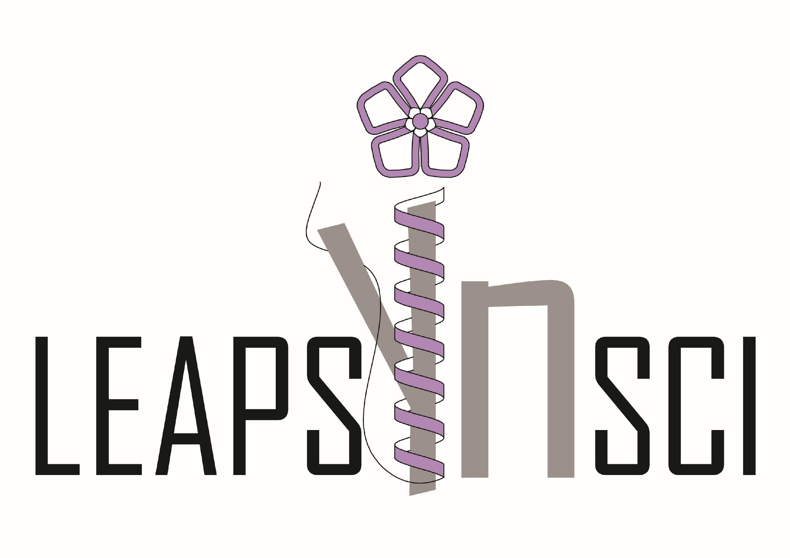





Brain Awareness Week 2022
Late Embryogenesis Abundant Proteins: Structural
Characterisation and Interaction with α-Synuclein
Science Fund of the Republic of Serbia, Program for Excellent Projects of Young Researchers
Notes:
poboljsajte rezoluciju za imgge i za imsi logoe
1

Slide 2

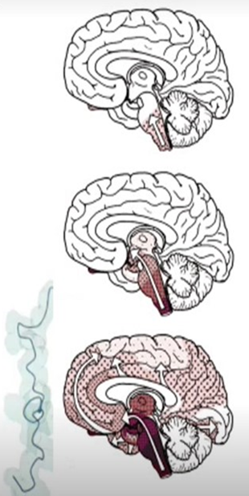




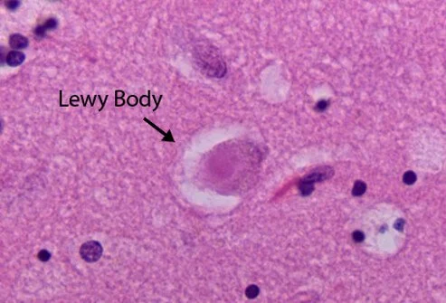
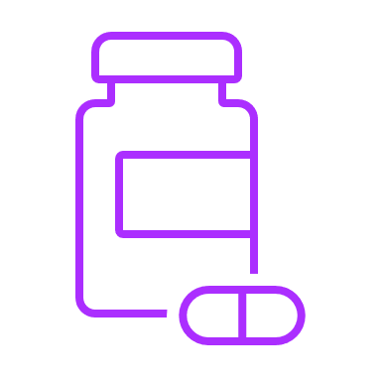
Parkinson`s Disease
The second most common chronic progressive neurodegenerative disease
There are over 10 million patients in the world
About 14,000 patients in Serbia
The most often affected people are between the age of 50 and 70 years
There is no causative therapy
alpha - synuclein
Protein of 140 amino acids, 14kDa
Function - communication between neurons in the brain
Abnormal folding of aphla synuclein proteins due to gene mutations
A non-functional protein is formed, most often insoluble - aggregates - toxic to cells
Brain awareness week 2022
Notes:
2

Slide 3

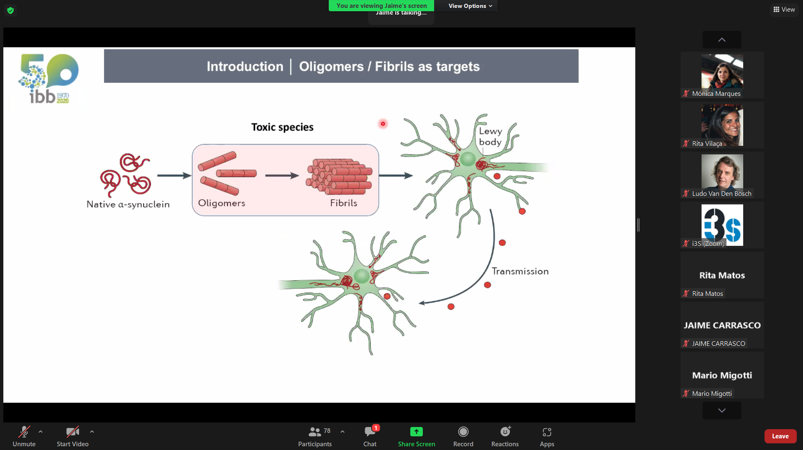
Current Issue this Week:
Be Aware of α – Synuclein Aggregation!
NAC
Hallmark of Parkinson's disease: Intracellular protein aggregates are composed of α-synuclein monomers
U.S. National Institute of Neurological Disorders and Stroke: "A key objective for researchers moving forward is to better understand the normal and abnormal functions of alpha-synuclein and its relationship to genetic mutations that impact PD"
Brain awareness week 2022
Notes:
3

Slide 4
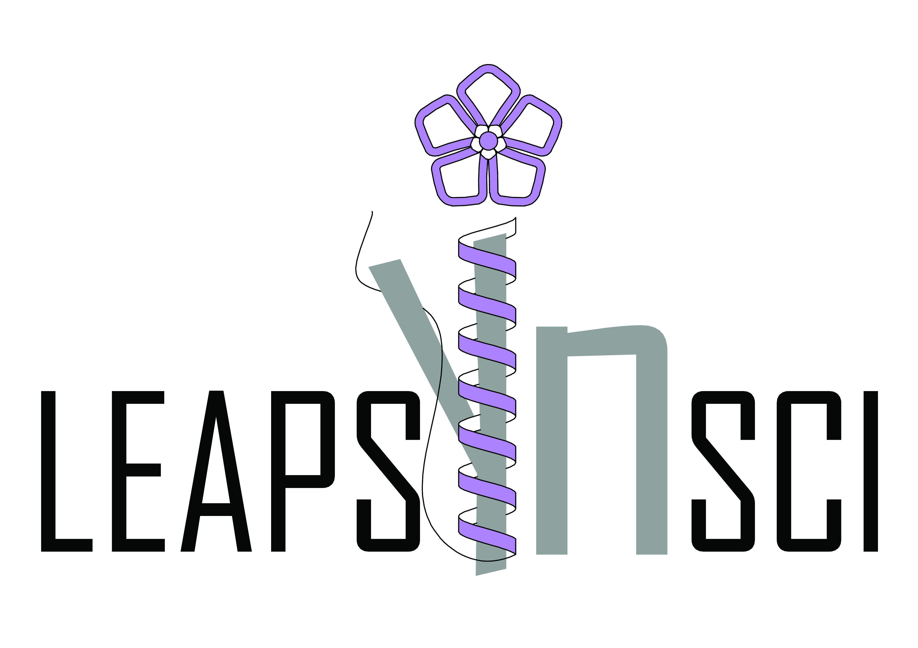
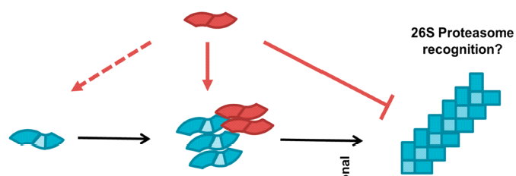
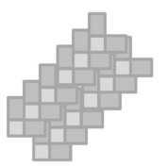
Can LEA proteins interfere with α – Synuclein Aggregation?
Examining the nature of the interaction between LEA protein and α-Syn
  Which step during α-Syn aggregation can be affected by recombinant LEA proteins?
  Does the LEA protein interact with α-Syn at the level of monomers, dimers or trimers, or with already formed aggregates?
  Under which conditions (pH, temperature, ionic strength, solvent polarity)?
  Which partners can influence the α-Syn anti-aggregation activity of LEA protein?
LEAPs?
LEAP
α­—­­Syn
Monomer Oligomers
Fibrils
Aggregates
Brain awareness week 2022
Notes:
popravite semu

Slide 5

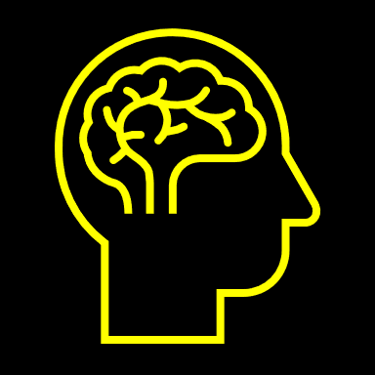
Can the LEAPs Change the Course of
Current Treatment of Parkinson`s Disease
Although Parkinson’s disease was originally described in 1807, the cure for this disorder has not yet been discovered.
Current Therapy
Most drugs - replenish dopamine
NEW STRATEGIES
Small molecules could interfere with the aggregation of α-Syn
Endogenues peptides
Autophagy of amyloid fibrils
Gene therapy and stem cell therapy
Immunotherapy (passive immunization)
The main goal of our project:
Preventing α-Synuclein aggregation with LEA proteins, induced during dessication, may lead to the development of new strategies for the treatment of Parkinson's disease using causative therapy, instead of the only therapy available today – symptomatic therapy.
Brain awareness week 2022
Notes:
5

Slide 6
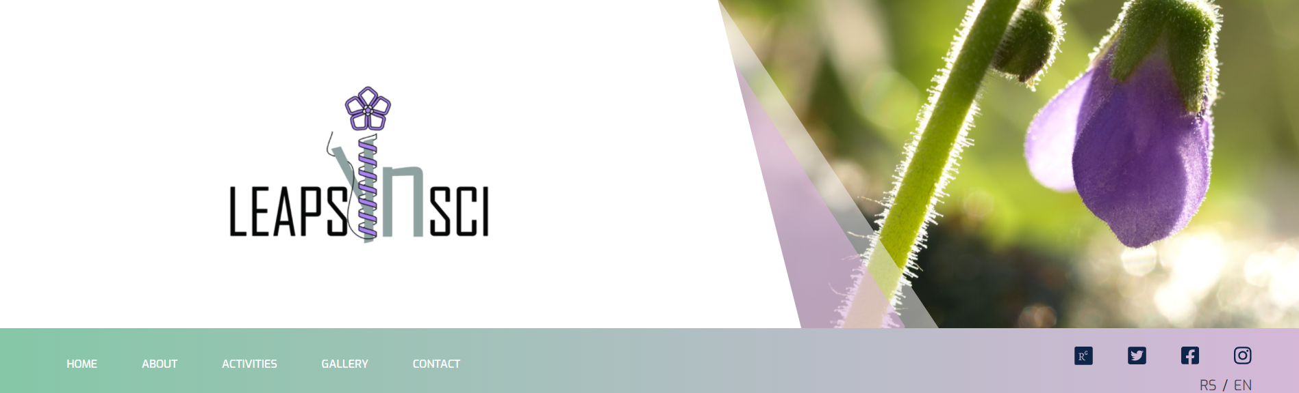
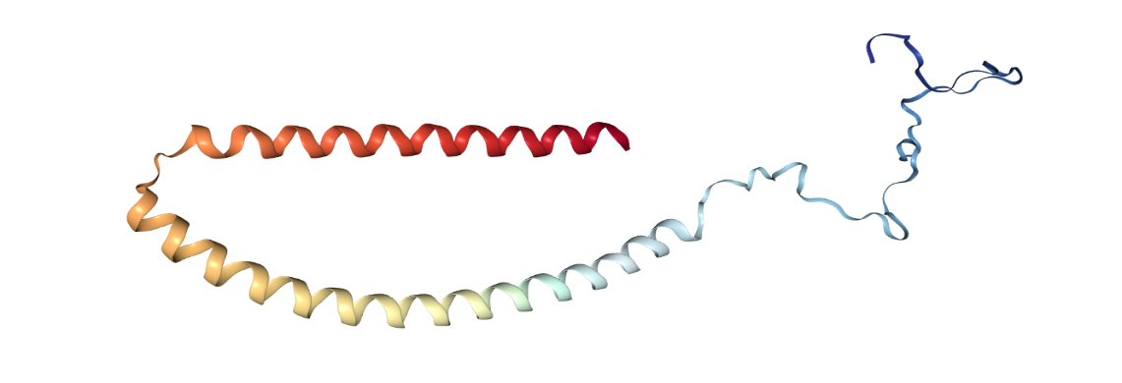
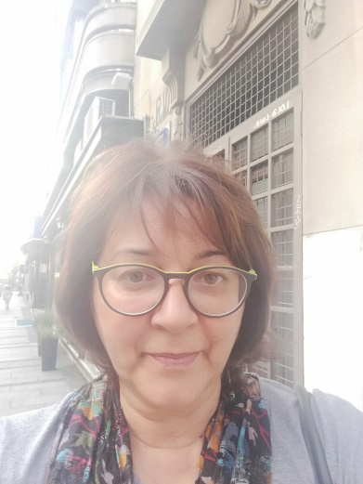
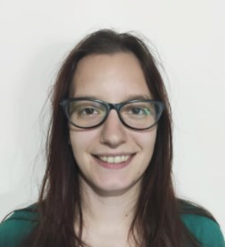
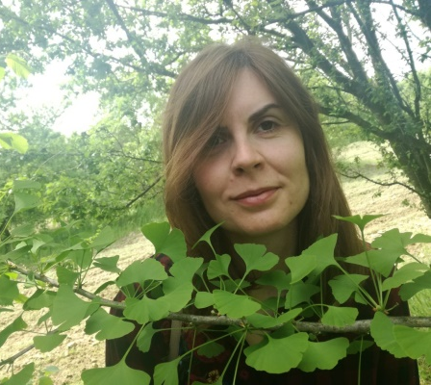
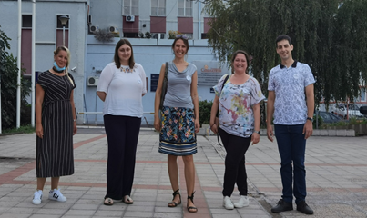
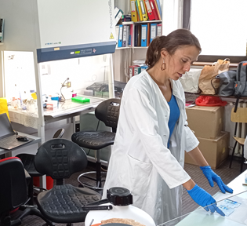
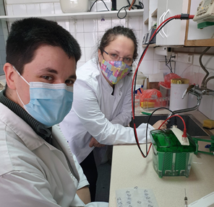
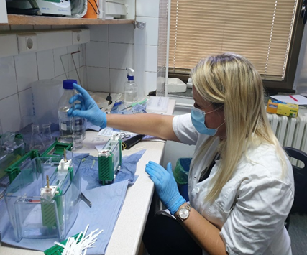
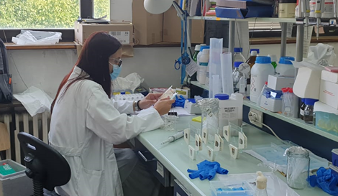
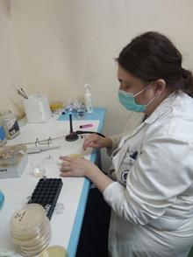
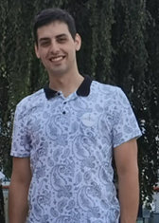
https://leapsynsci.com/
Follow us on social media:
Youtube: (https://www.youtube.com/watch?v=QHUE1SSARdU).
Research gate https://www.researchgate.net/project/LEAPSyn-SCI-Late-Embryogenesis-Abundant-Proteins-Structural-Characterisation-and-Interaction-with-a-Synuclein-2
Twitter: https://twitter.com/leapsyn
Instagram: https://www.instagram.com/leapsyn_sci/?hl=fr-ca
Facebook: https://www.facebook.com/leapsynsci/
Science Fund of the Republic of Serbia
Program for Excellent Projects of Young Researchers
Brain awareness week 2022
Notes:
6

